Slide 1



On the use of factor analysis and iClasses to assess variety by environment interactions in falling number across Australia
David Hughes¹
William Fairlie², Alison Smith¹, Marijka Batterham¹ & Brian Cullis¹
AASC2022
¹Centre for Biometrics and Data Science for Sustainable Primary Industries (CBADS-SPI) National Institute for Applied Statistics Research Australia, University of Wollongong, Wollongong, NSW
²AGT, Roseworthy, SA, AUS
hughesd@uow.edu.au
@DaveDoesStats
Notes:
Hello all,
My name is David Hughes, I’m a PhD student at university of Wollongong, supervised by Brian Cullis, Alison Smith and Marijka Batterham, and this work was in collaboration with William Fairlie from AGT.
My talk today is on the use of factor analysis and iClasses to assess variety by environment interactions in falling number across Australia.
And considering its now December, I thought I should use a Christmas themed gif.

Slide 2

Acknowledgements
Haydn Kuchel (AGT)
Richard Williams
Nicole Cocks
PhD Supervisors
Notes:
Before I start, I’d like to thank the AGT and GRDC for allowing the use of their data. I’d like to thank my team and previous colleagues in this project, and finally my PhD supervisors.

Slide 3
The Problem
Late maturity α-amylase (LMA) expression is one of the many challenges facing the Australian wheat breeding industry.
LMA is an enzyme that degrades starch into sugars.
It is triggered by specific sequences of environmental conditions [Mares and Mrva, 2014].
Notes:
Read bold parts

Slide 4
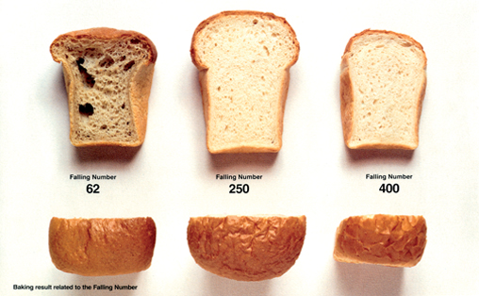
The Problem – Measuring LMA
Falling number (FN) is a trait that measures starch degradation due to the presence of α-amylase.
There are 2 main causes of low FN:
Pre-harvest sprouting (PHS)
LMA
Growers’ crops are downgraded if FN is low.
Notes:
One way we can measure this is through falling number.
Example of what the end product looks like with a low to high FN value.
2 main causes of FN, PHS and LMA (the latter is of interest to our work).

Slide 5
The Problem – Estimating LMA
The Problem
LMA expression is influenced by the variety (V), environment (E), and their interaction (VEI).
This can be explored using FN data from a multi-environment trial (MET) data-set.
Notes:
LMA expression is influenced both by the variety (V) and the environment (E), and most likely, their interaction (VEI).
The most feasible way to explore this is using FN data from a multi-environment trial (MET) data-set which needs to be extensive, given the unpredictable nature of expression.

Slide 6
The Problem – Estimating LMA
The Problem
Previously, Sjoberg et al. (2020) undertook a study to examine VEI in FN.
Compiled a MET data-set comprising 35 trials conducted in 2013, 2014 and 2016 in locations across north-west USA.
Fitted a (1-stage) factor analytic linear mixed model (FALMM) and used factor analytic selection tools (FAST) of Smith and Cullis (2018) to examine overall performance (OP) and stability (RMSD) of varieties.
Concluded that environment loadings enabled differentiation of low FN environments between those caused by PHS or LMA and claimed that this provided a method to objectively rank varieties for grower and breeder selections.

Slide 7
The Problem – Estimating LMA
The Problem
Recently, Smith et al. (2021) introduced the concept of interaction classes (iClasses), which extend the FAST approach to provide more meaningful measures of variety performance in the presence of VEI.
We will illustrate this through the use of a (single-stage) FALMM and iClasses for FN in a rich Australian MET data-set.
Notes:
Recently, Smith et al. (2021) introduced the concept of interaction classes (iClasses), which extend the FAST approach to provide more meaningful measures of variety performance in the presence of VEI.
In this talk, we illustrate the use of a (single-stage) FALMM and iClasses for FN in a rich Australian MET data-set.

Slide 8
FN MET Data-set
245 designed field trials across Australia over the period 2014–2019.
37 excluded either because early sown or exhibited low FN due to PHS (as identified by researchers).
Trials sourced through GRDC or AGT.
A total of 124 varieties across 208 retained trials.
Year | #Trials | #Varieties
2014 | 19 | 24
2015 | 57 | 25
2016 | 54 | 24
2017 | 42 | 24
2018 | 15 | 24
2019 | 21 | 123
Notes:
Briefly, the data-set contained trials across Australia from 2014-2019.
These were sourced through AGT and GRDC, and after removing a few due to several reasons, we ended up with 124 unique varieties across 208 trials. The table on the right shows the breakdown of the number of trials and varieties each year.

Slide 9

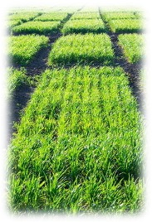
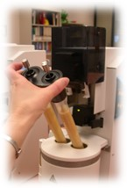
The Problem
The Problem – Measuring FN
Phase I
Field Trial
Phase II
Laboratory Measurement
Notes:
FN is measured as the end product of a multiphase trial, specifically 2 phases, field trials and laboratory measurements.
We can partition our data into 5 sets, each with different design elements in the field and/or laboratory phases.
Here, I will present an example of a trial belonging to the set with the most complex of designs.
Looking at the field phase CLICK
Briefly, here’s an example of a Falling number machine.
The procedure involves grain samples being ground into a flour, and inserted into either Tube of this machine.
Water is mixed with this flour using a stirring rod to form a slurry.
This rod is then released from the top of the mixture and the Falling number measurement is calculated as time needed for the rod to reach the bottom of the tube in seconds. Less starch means it’ll fall quicker.
A laboratory design for this example trial can look like this. (CLICK)

Slide 10
2 field replicates
1 lab sample each
1 field replicate
2 lab samples (duplicates)
1 field replicate 1 lab sample
105 unique varieties
(66=1rep, 39=2rep)
p-rep% = 37.1%
144 Field Plots
Notes:
This trial was a partially replicated (p-rep) design where the replicate blocks are outlined by the dark line (i.e. column blocks). Other examples of trials across this data-set include ones designed as 2 rep randomised complete block designs, replicated in either 1- or 2-directions.
Plots shaded dark grey are field replicated plots and plots shaded light grey and white have only one field replicate.
There were 105 unique varieties, with a p-rep percentage at 37.1%. These were sown in a field with 24 ranges and 6 rows, which gives 144 field plots.
Upon harvest, it was decided that Field plots with 2 reps would each have a lab sample. Field plots with one rep (light grey) were to be duplicated in the laboratory phase so that they had 2 lab samples.
And field plots shaded white would only have a single laboratory sample. Hence, there were 177 samples from which a FN measurement will be taken in the laboratory phase.

Slide 11
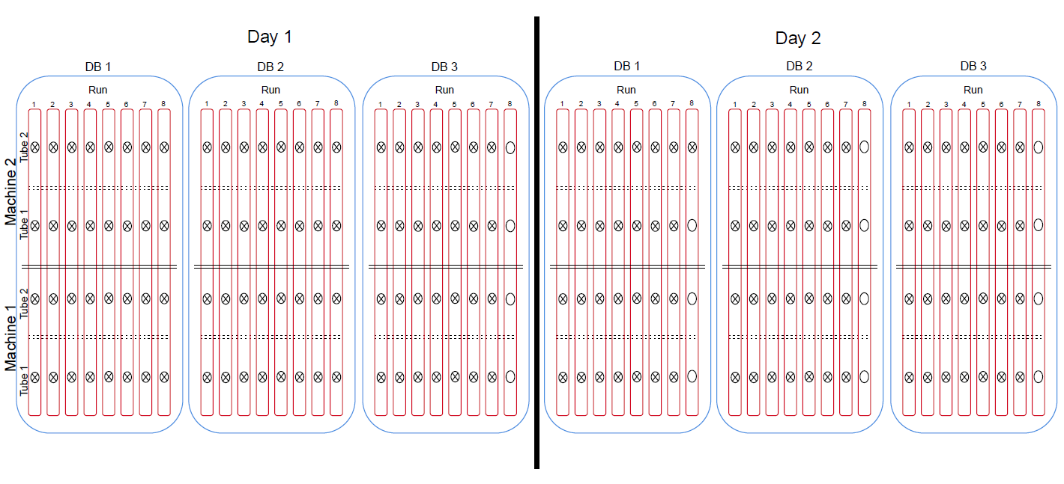
105 unique varieties
144 Field Plots
177 Laboratory Samples
Notes:
Here is a graphical representation of the laboratory phase of this example trial.
As mentioned earlier, field plots were partially replicated in such a way that form the 144 field plots, we now had 177 laboratory samples
Each of those Laboratory samples processed are depicted by crossed circles, and empty slots are depicted by open circles.
There was a maximum of two Machines, each with two Tubes, that measured falling number simultaneously.
Samples from trials were processed over a number of Days.
The randomised order of laboratory samples over the course of a Day were split into three Day Blocks (DB), corresponding to morning, midday, and afternoon.
Laboratory samples measured concurrently across Machines were denoted as a Run (up to 8 within a DB).
As I’ve mentioned, this was one of the more statistically designed trials in our data-set.
Other trials in this data-set differ in laboratory designs with either having field plots equal to laboratory samples, the presence or absence of laboratory factors (i.e. machine and/or tube), and the slurries formed from each field plot (1 or 2).
With all the statistical designs outlined, let’s now talk about something we all love…

Slide 12


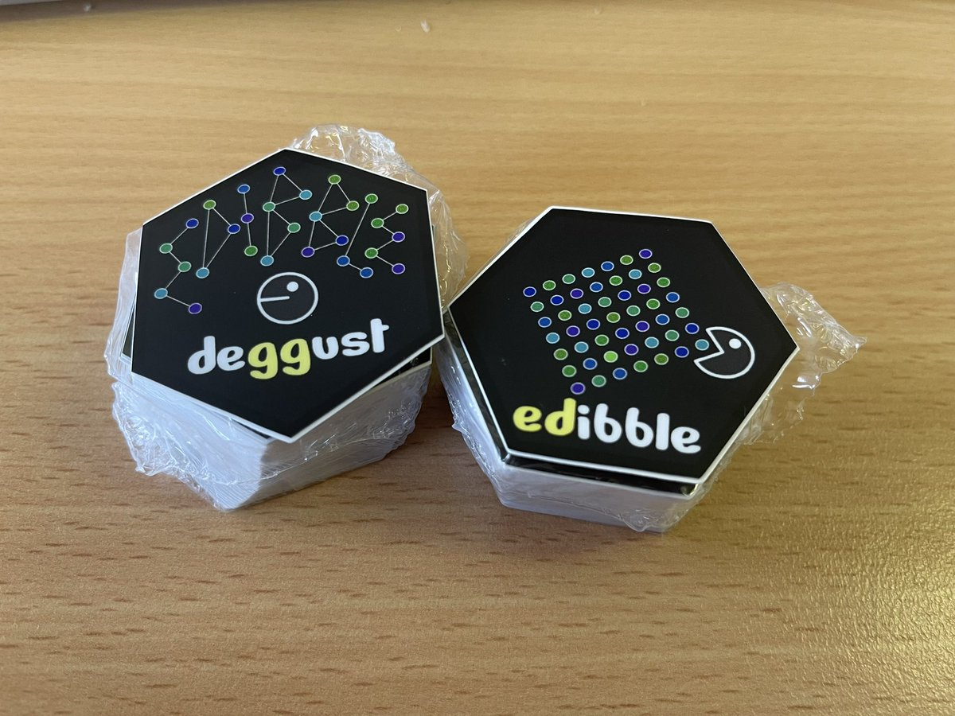

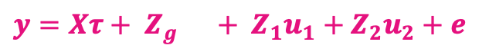

Random effects:
Peripheral effects from each phase
Fixed effects: Experiment
$$y=Xτ+ Z_{g} + Z_{1}u_{1}+Z_{2}u_{2}+e$$
Random effects:
VEI
Residuals
Notes:
Genstat??? Wait no… that’s not right.
CLICK
Rstudio and ggplot? I mean, I do like visualisations, and after Emi’s talk, CLICK maybe that should be updated… but no that’s not right.
CLICK
Ahh yes, THE LINEAR MIXED MODEL.
Here’s the Linear mixed model we all love, but with random effects corresponding to the two phases of this multi-phase experiment.
First term is our fixed effect which contains our experiment factor.
Let’s skip the genetic effects for a second. We have our peripheral effects from each phase, which were the designs implemented as shown in the previous slides.
We have our residuals, which are gaussian zero mean independent and identically distributed and all that.
And here are our VEI (variety by environment interaction effects) for which were modelled with single stage factor analytic structure.

Slide 13
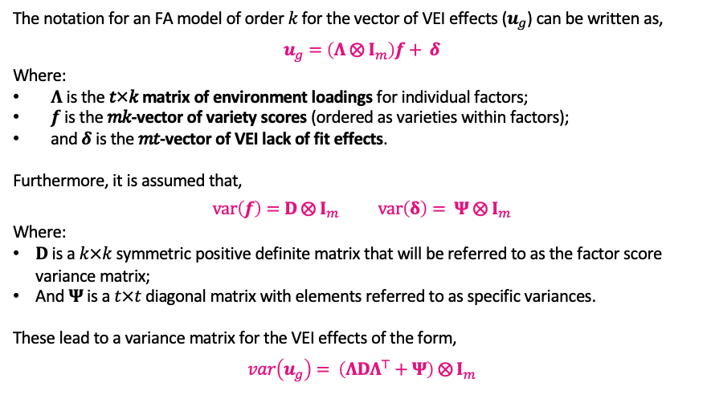
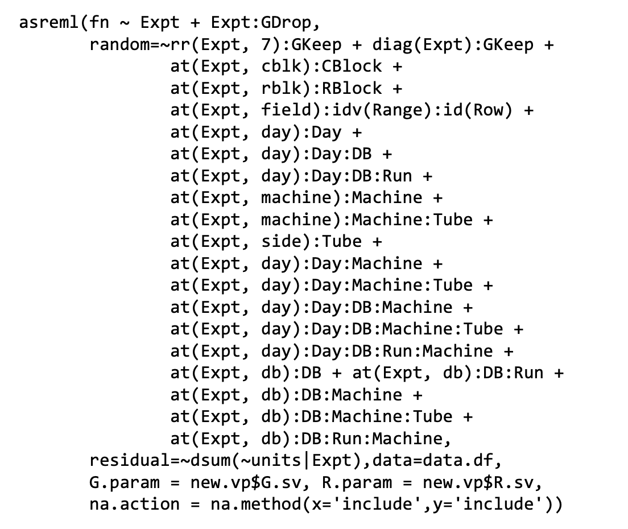
FALMM Model
The notation for an FA model of order 𝑘 for the vector of VEI effects ($u_{g}$) can be written as,
$$u_{g}=\left(Λ ⨂{ I}_{m}\right)f+ δ$$
Where:
𝚲 is the 𝑡×𝑘 matrix of environment loadings for individual factors;
𝒇 is the 𝑚𝑘-vector of variety scores (ordered as varieties within factors);
and 𝜹 is the 𝑚𝑡-vector of VEI lack of fit effects.
Furthermore, it is assumed that,
$$\begin{matrix}var\left(f\right)=D ⨂{ I}_{m} & & var\left(δ\right)= Ψ ⨂{ I}_{m}\end{matrix}$$
Where:
$D$ is a $k×k$ symmetric positive definite matrix that will be referred to as the factor score variance matrix;
And $Ψ$ is a $t×t$ diagonal matrix with elements referred to as specific variances.
These lead to a variance matrix for the VEI effects of the form,
$$var\left(u_{g}\right)= \left(ΛDΛ^{⊤}+Ψ\right) ⨂{ I}_{m}$$
Notes:
The notation fo the FA models of order k for the VEI effects can be written as such, ETC ETC.
Furthermore, the variance structures for these terms are assumed as such, where ETC.
This leads to the variance matrix for the VEI effects to be of the form ….
Now that we’ve presented the algebra, let’s look at fitting the model. CLICK FOR CODE

Slide 14
Model fitting
Model fitting summary of each FAk variance model fitted to the Environment:Variety effects, including the REML log-likelihood, Akaike information criterion, increase in number of factor analytic parameters fitted (ΔFA), and percentage of variance accounted for by the model (%VAF).
asreml(fn ~ Expt + Expt:GDrop,
random=~rr(Expt, 7):GKeep + diag(Expt):GKeep +
at(Expt, cblk):CBlock +
at(Expt, rblk):RBlock +
at(Expt, field):idv(Range):id(Row) +
at(Expt, day):Day +
at(Expt, day):Day:DB +
at(Expt, day):Day:DB:Run +
at(Expt, machine):Machine +
at(Expt, machine):Machine:Tube +
at(Expt, side):Tube +
at(Expt, day):Day:Machine +
at(Expt, day):Day:Machine:Tube +
at(Expt, day):Day:DB:Machine +
at(Expt, day):Day:DB:Machine:Tube +
at(Expt, day):Day:DB:Run:Machine +
at(Expt, db):DB + at(Expt, db):DB:Run +
at(Expt, db):DB:Machine +
at(Expt, db):DB:Machine:Tube +
at(Expt, db):DB:Run:Machine,
residual=~dsum(~units|Expt),data=data.df,
G.param = new.vp$G.sv, R.param = new.vp$R.sv,
na.action = na.method(x='include',y='include'))
Field
Model | REML-logl | AIC | ΔFA | %VAF
1 | -71880.31 | 146856.6 | 208 | 50
2 | -71310.08 | 146130.2 | 207 | 58
3 | -71013.10 | 145948.2 | 206 | 65
4 | -70640.74 | 145613.5 | 205 | 77
5 | -70325.23 | 145390.5 | 204 | 83
6 | -70030.40 | 145206.8 | 203 | 87
7 | -69791.52 | 145133.0 | 202 | 90
Laboratory
Notes:
Here, you can see the code we used to analyse this extensive data-set.
The second line specifies the FA model split as an RR + DIAG which is our common (LAM D LAM) and specific (PSI) variety by environment interaction effects.
This allows us to retrieve the relevant parts of the model necessary for these summary tools, i.e. FAST and iClasses.
CLICK
The terms at the top represent the field blocks (such as replicate blocks, and individual field plots)
And the bottom terms correspond to the combinations of potential sources of variation in the laboratory. Note that most of these were measurable.
CLICK
Here is the summary of each FA model we fitted to this data.
Using a combination of REML-loglikelihoods, AIC values, %VAF and REML-LRTs,
CLICK
it was decided that results will be presented from the FA7 model.
As an Aside, the loadings from this model are rotated to a principal component solution, hence why I’ll call them ‘rotated’ loadings from here on out.

Slide 15
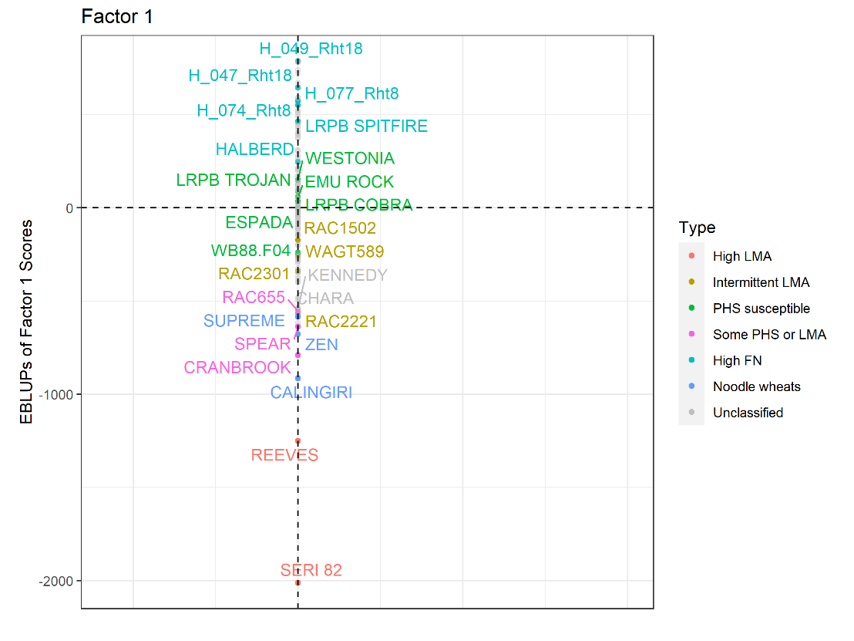

Notes:
Looking at the variety scores from the first factor with Varieties coloured according to a crude classification
We can see that this first factor clearly displays a variety's general propensity to express LMA, remember that low is bad on this plot.
Note how typical LMA varieties like SERI and REEVES are at the bottom, and as we go up, they are less likely to be susceptible to LMA, to then some PHS varieties, and finally some high FN lines are at the top like Spitfire and Halberd
In our results, the rotated loadings for the first factor were mostly all positive,
CLICK
so we would naturally use FAST to give researchers singular values for overall performance and stability.

Slide 16
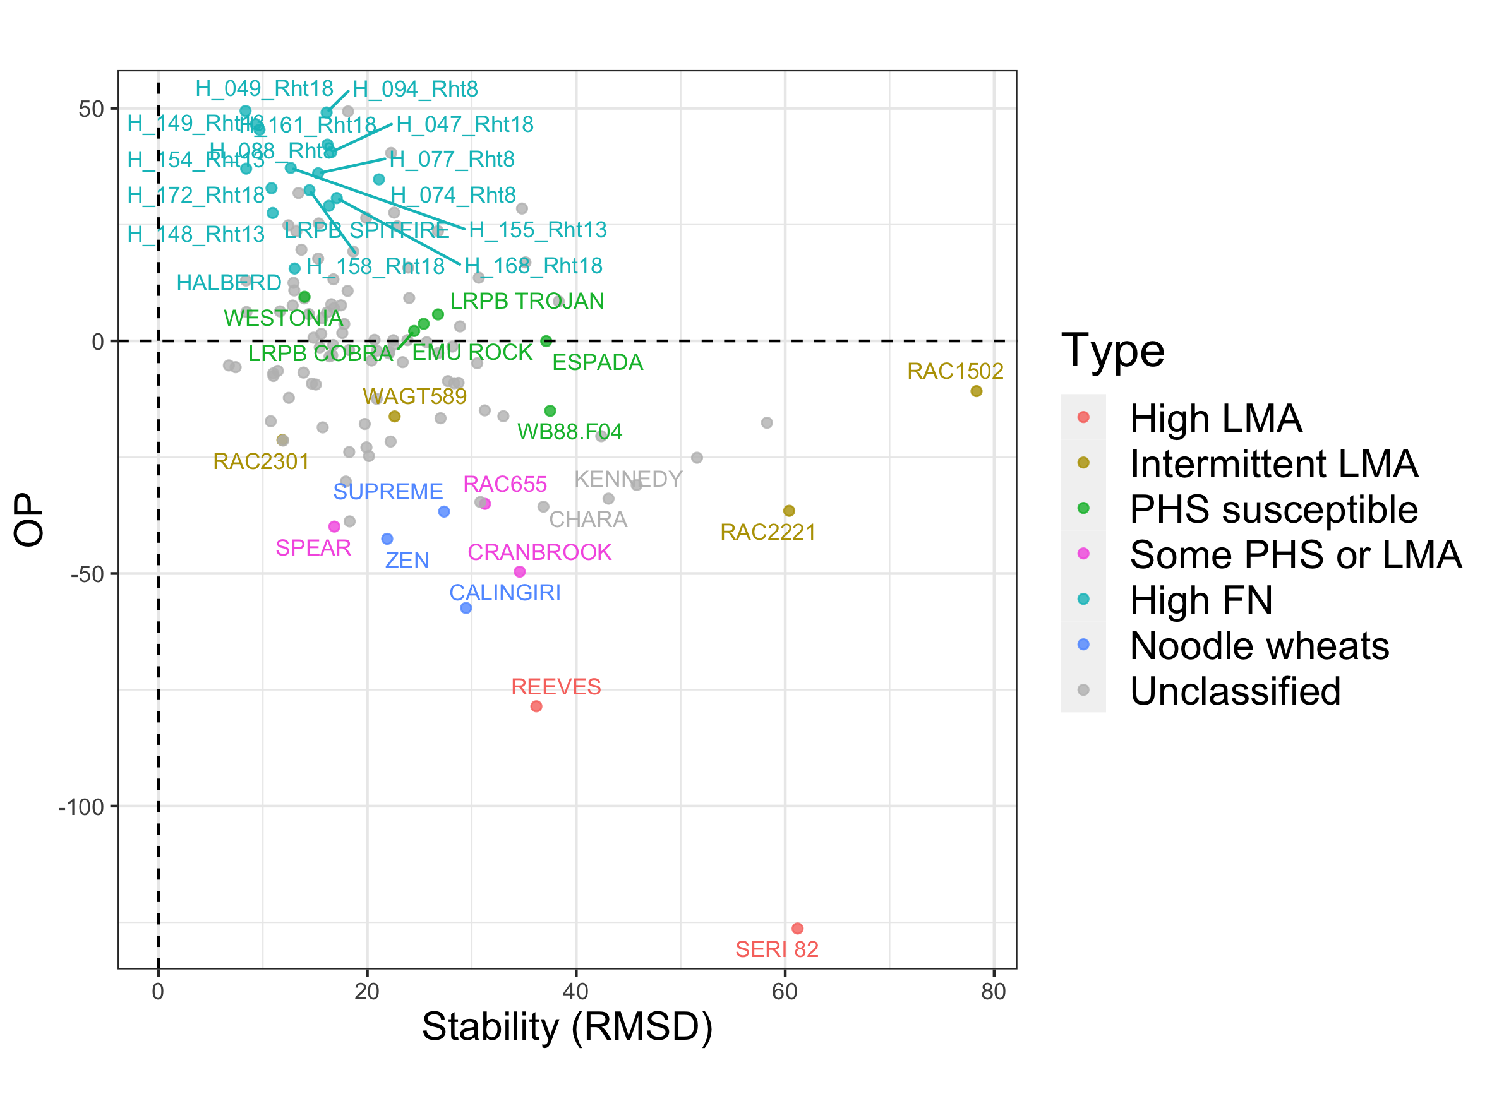

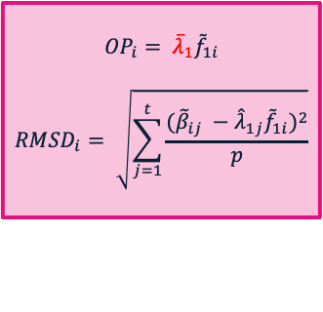
FAST [Smith et al., 2018]
$${OP}_{i}= {\overline{λ}}_{1}{\tilde{f}}_{1i}$$
$${RMSD}_{i}= \sqrt{\sum_{j=1}^{t}{\frac{({\tilde{β}}_{ij} −{\hat{λ}}_{1j}{\tilde{f}}_{1i})^{2}}{p}}}$$
Notes:
Here is an example of the plots of OP and stability that we would provide to researchers. Note how OP is calculated with the mean of the rotated loadings from ONLY the first factor…
CLICK well steady on champ.
we need to be cautious because there's seems to be more going on in this trait.
Remember, we fit 7 factors!
That suggests high VEI.
Is it sensible to only use the average rotated loading from the first factor?

Slide 17
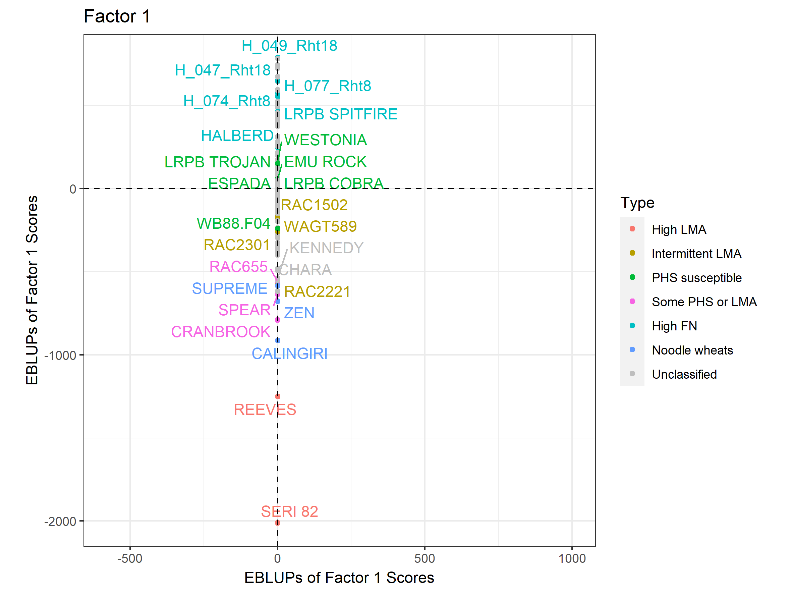
Notes:
ANIMATION
Going back to the variety scores plot, and let’s introduce the second factor against the first,
We can see varieties starting to move around.
This shifting represents the contrasts between varieties.
That is, their reaction to some implicit covariate in environments described by this second factor in this analysis.

Slide 18
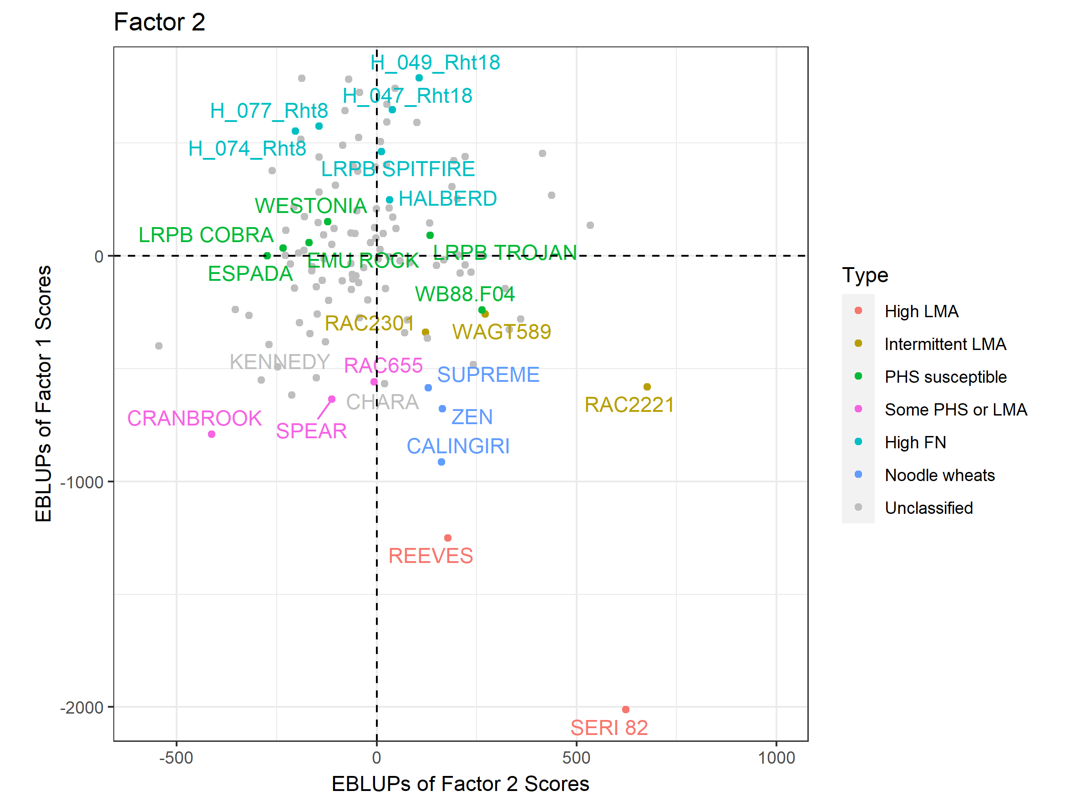
Notes:
ANIMATION
- Similarly for the third factor, there are some massive shifts for varieties such as RAC2221 or Kennedy
These factors can be described as 'bipolar’, and they represent the VEI that's present in the data-set.
It’s because of VEI that researchers were uncomfortable with the idea of one value for performance and stability in a trait that's as variable as this is.

Slide 19
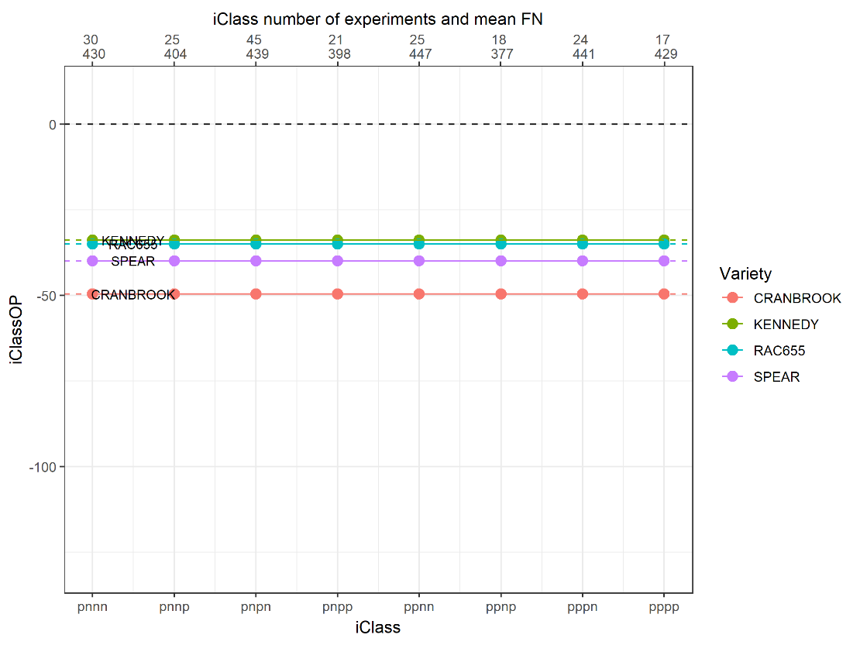

Notes:
Here I’ll present an example of why FAST tools were not the best when VEI is present in the data.
Let's take those OP values from before and whack them on this plot.
These all seem to be very similar but we know there’s large amounts of VEI in this data.
CLICK
This is where iClasses come in.

Slide 20
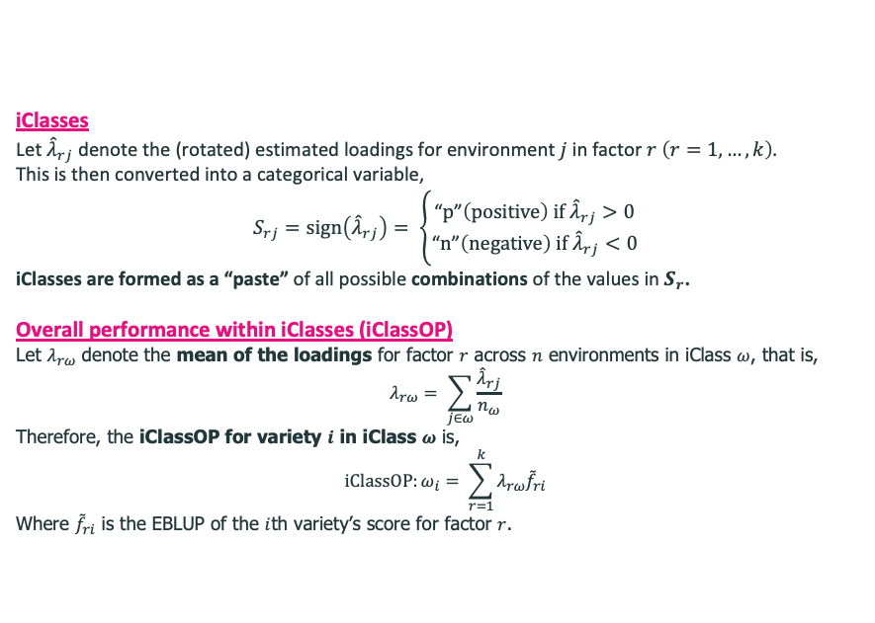
Interaction Classes (iClass) [Smith et al., 2021]
iClasses
Let ${\hat{λ}}_{rj}$ denote the (rotated) estimated loadings for environment $j$ in factor $r \left(r=1,…,k\right).$
This is then converted into a categorical variable,
$$S_{rj}=sign\left({\hat{λ}}_{rj}\right)= \left\{\begin{aligned}\text{“}p\text{”}\left(positive\right) if {\hat{λ}}_{rj}>0 \\ \text{“}n\text{”}\left(negative\right) if {\hat{λ}}_{rj}<0\end{aligned}\right.$$
iClasses are formed as a “paste” of all possible combinations of the values in $S_{r}$.
Overall performance within iClasses (iClassOP)
Let ${\overline{λ}}_{rω}$ denote the mean of the loadings for factor $r$ across $n$ environments in iClass $ω$, that is,
$${\overline{λ}}_{rω}= \sum_{j∈ω}{\frac{{\hat{λ}}_{rj}}{n_{ω}}}$$
Therefore, the iClassOP for variety $i$ in iClass $ω$ is,
$$iClassOP:ω_{i}= \sum_{r=1}^{k}{{\overline{λ}}_{rω}{\tilde{f}}_{ri}}$$
Where ${\tilde{f}}_{ri}$ is the EBLUP of the $i$th variety’s score for factor $r$.
Notes:
Briefly, We define an iClass as the pasting of positive and negative loadings for EACH factor.
Each of these iClasses allow the grouping of environments, such that, within which, there is minimal cross-over VEI.
CLICK
Furthermore, we can now calculate OP in a similar manner to before but within each of these iclasses

Slide 21
Notes:
So let’s introduce iClasses to this plot.
CLICK
Along the bottom, you can see that we’ve used the first four factors of this analysis to generate the iClasses. This was because we found that most of the variation accounted for by this model was explained by the first four factors. We see that all environments fall into one of these 8 iClasses produced.
And At the top of the x-axis, we see the number of environments and the mean FN value for each iClass.
Now let me show you the problem when there’s substantial VEI in the data-set, and why iClass interaction plots are superior.

Slide 22
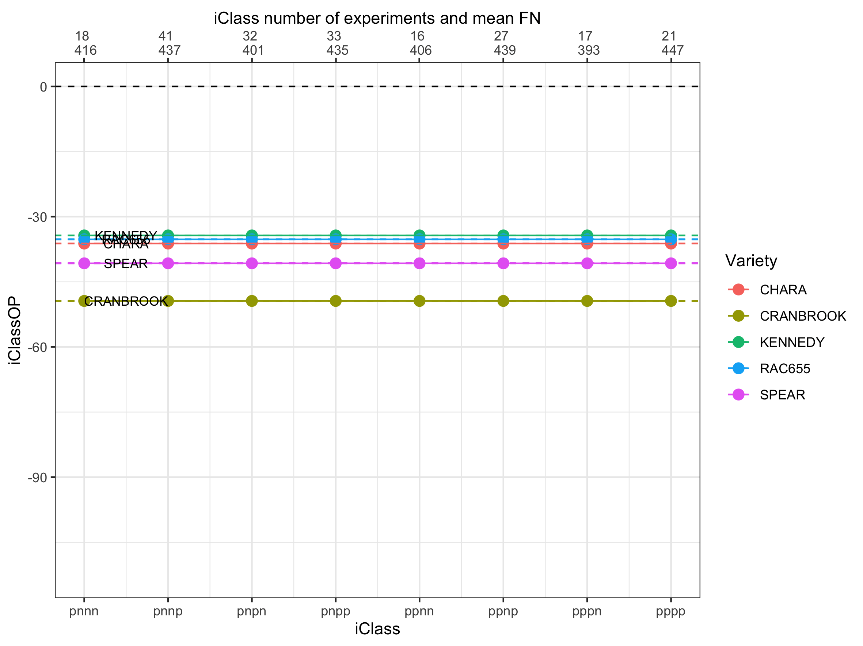
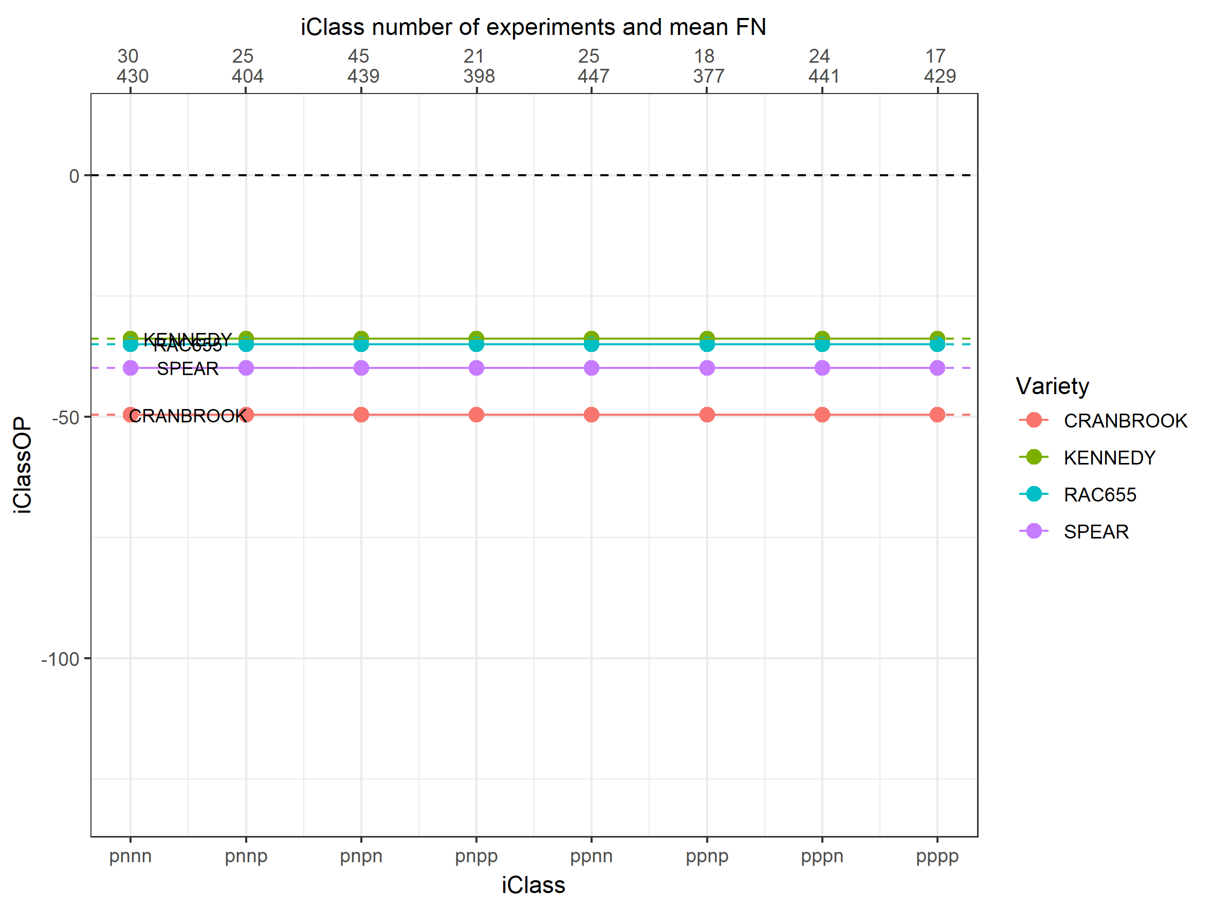
Notes:
ANIMATION
Moving to the iClass interaction plot you can now see how much cross-over VEI was masked by FAST,
Note the re-ranking that occurs within each iClass among these seemingly similar performing varieties.

Slide 23
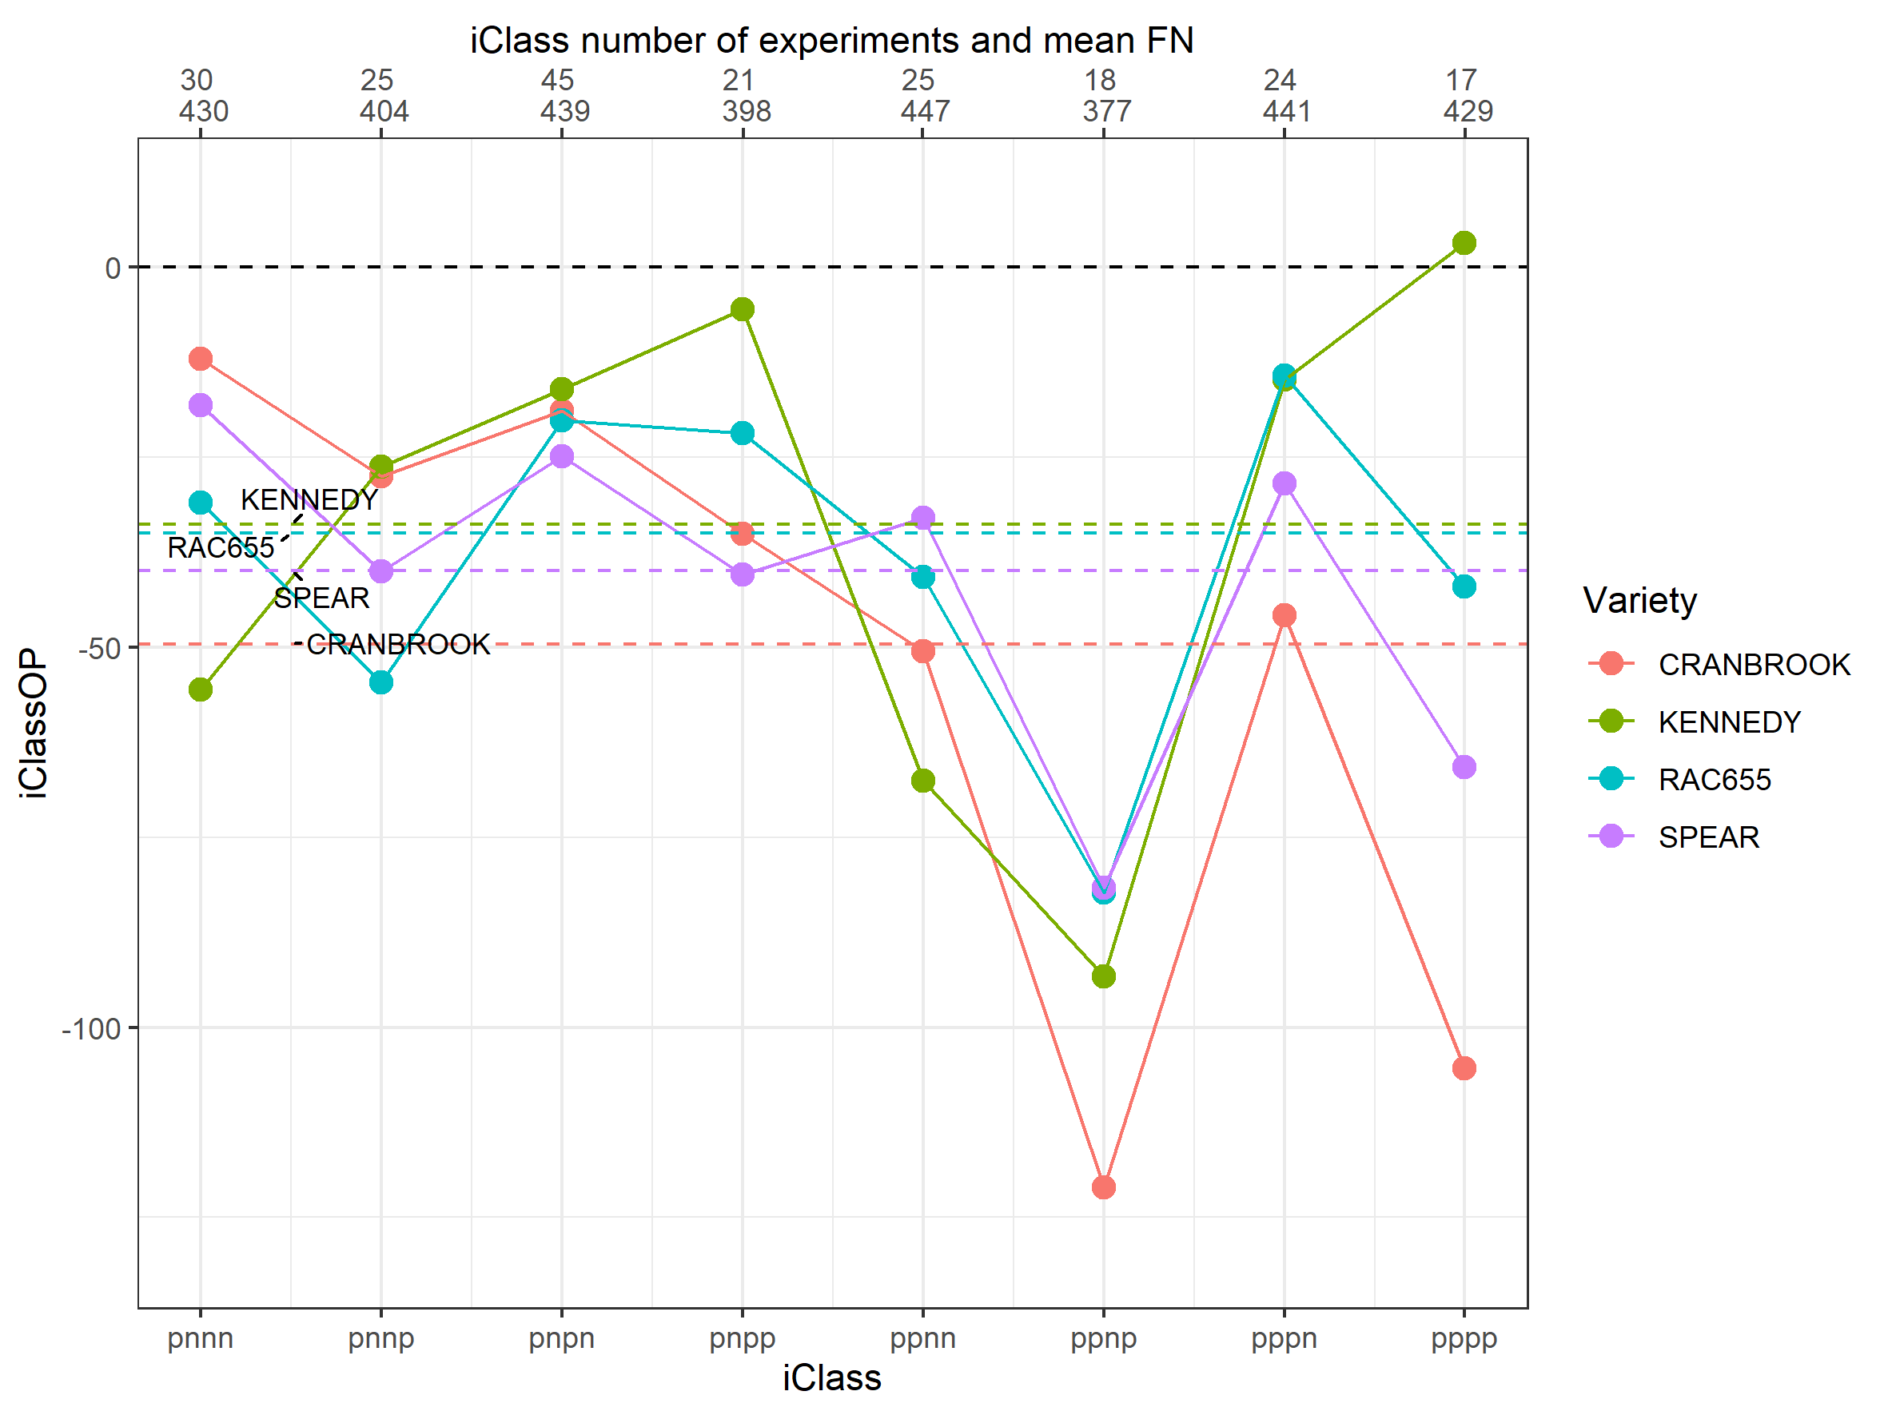
Variety | pnnn | pnnp | pnpn | pnpp | ppnn | ppnp | pppn | pppp
CRANBROOK | 0 | 1 | 0 | 2 | 1 | 11 | 1 | 6
KENNEDY | 1 | 1 | 0 | 0 | 1 | 11 | 0 | 0
RAC655 | 0 | 4 | 1 | 0 | 0 | 9 | 0 | 2
SPEAR | 0 | 1 | 0 | 2 | 1 | 8 | 0 | 3
Notes:
We can compare this diagram to a table of predictions of the number of environments within each iClass where a variety is predicted to have a low FN value (using the industry standard of 300 as the cut-off).
Graphically, these predictions align, again note that low is bad on these plots.
Third factor n/p seems to be causing issues
furthermore, researchers were able to look at the full table and determine which iClasses had low FN due to LMA and which were due to PHS.

Slide 24
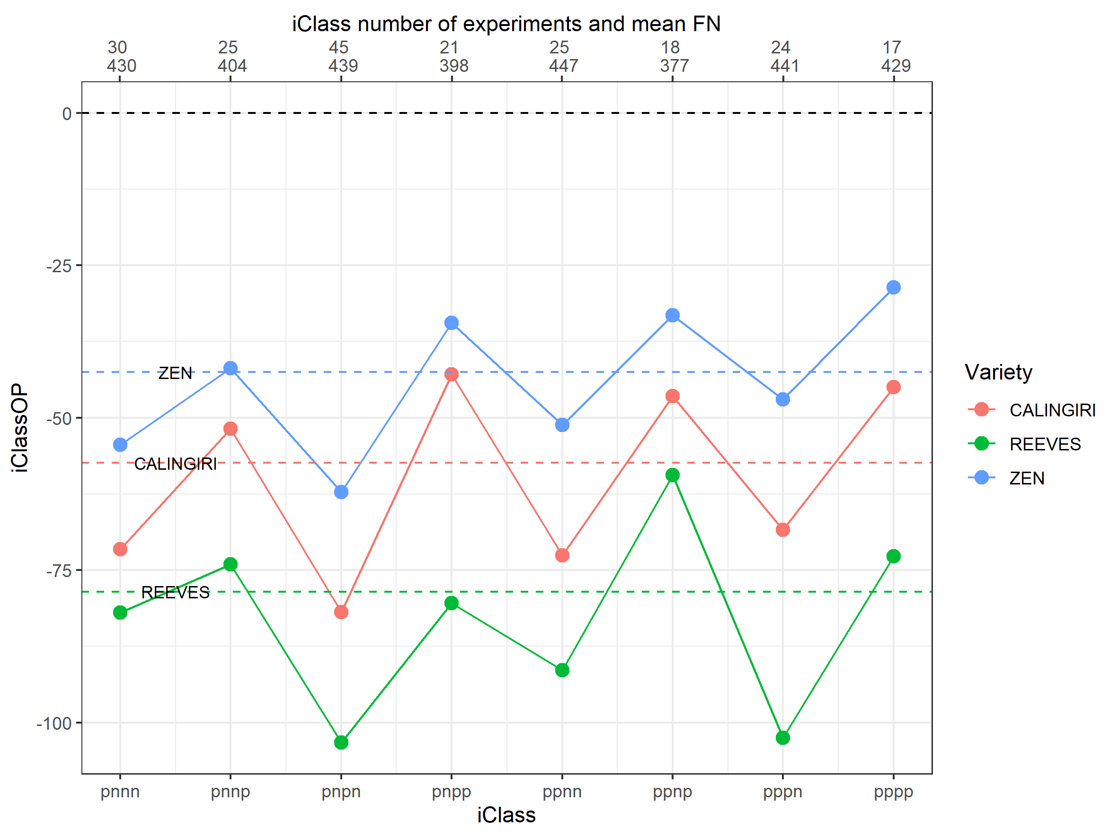
Notes:
The analyses and use of iClasses can also show the close relationships varieties have without the use of marker or pedigree data in the model.
Here we see varieties which are all derivatives of one another , REEVES, CALINGIRI and ZEN in that order, and how close their VEI patterns are matching just with different magnitudes
We can see that clearly something is happening in the fourth factor that affects them.

Slide 25
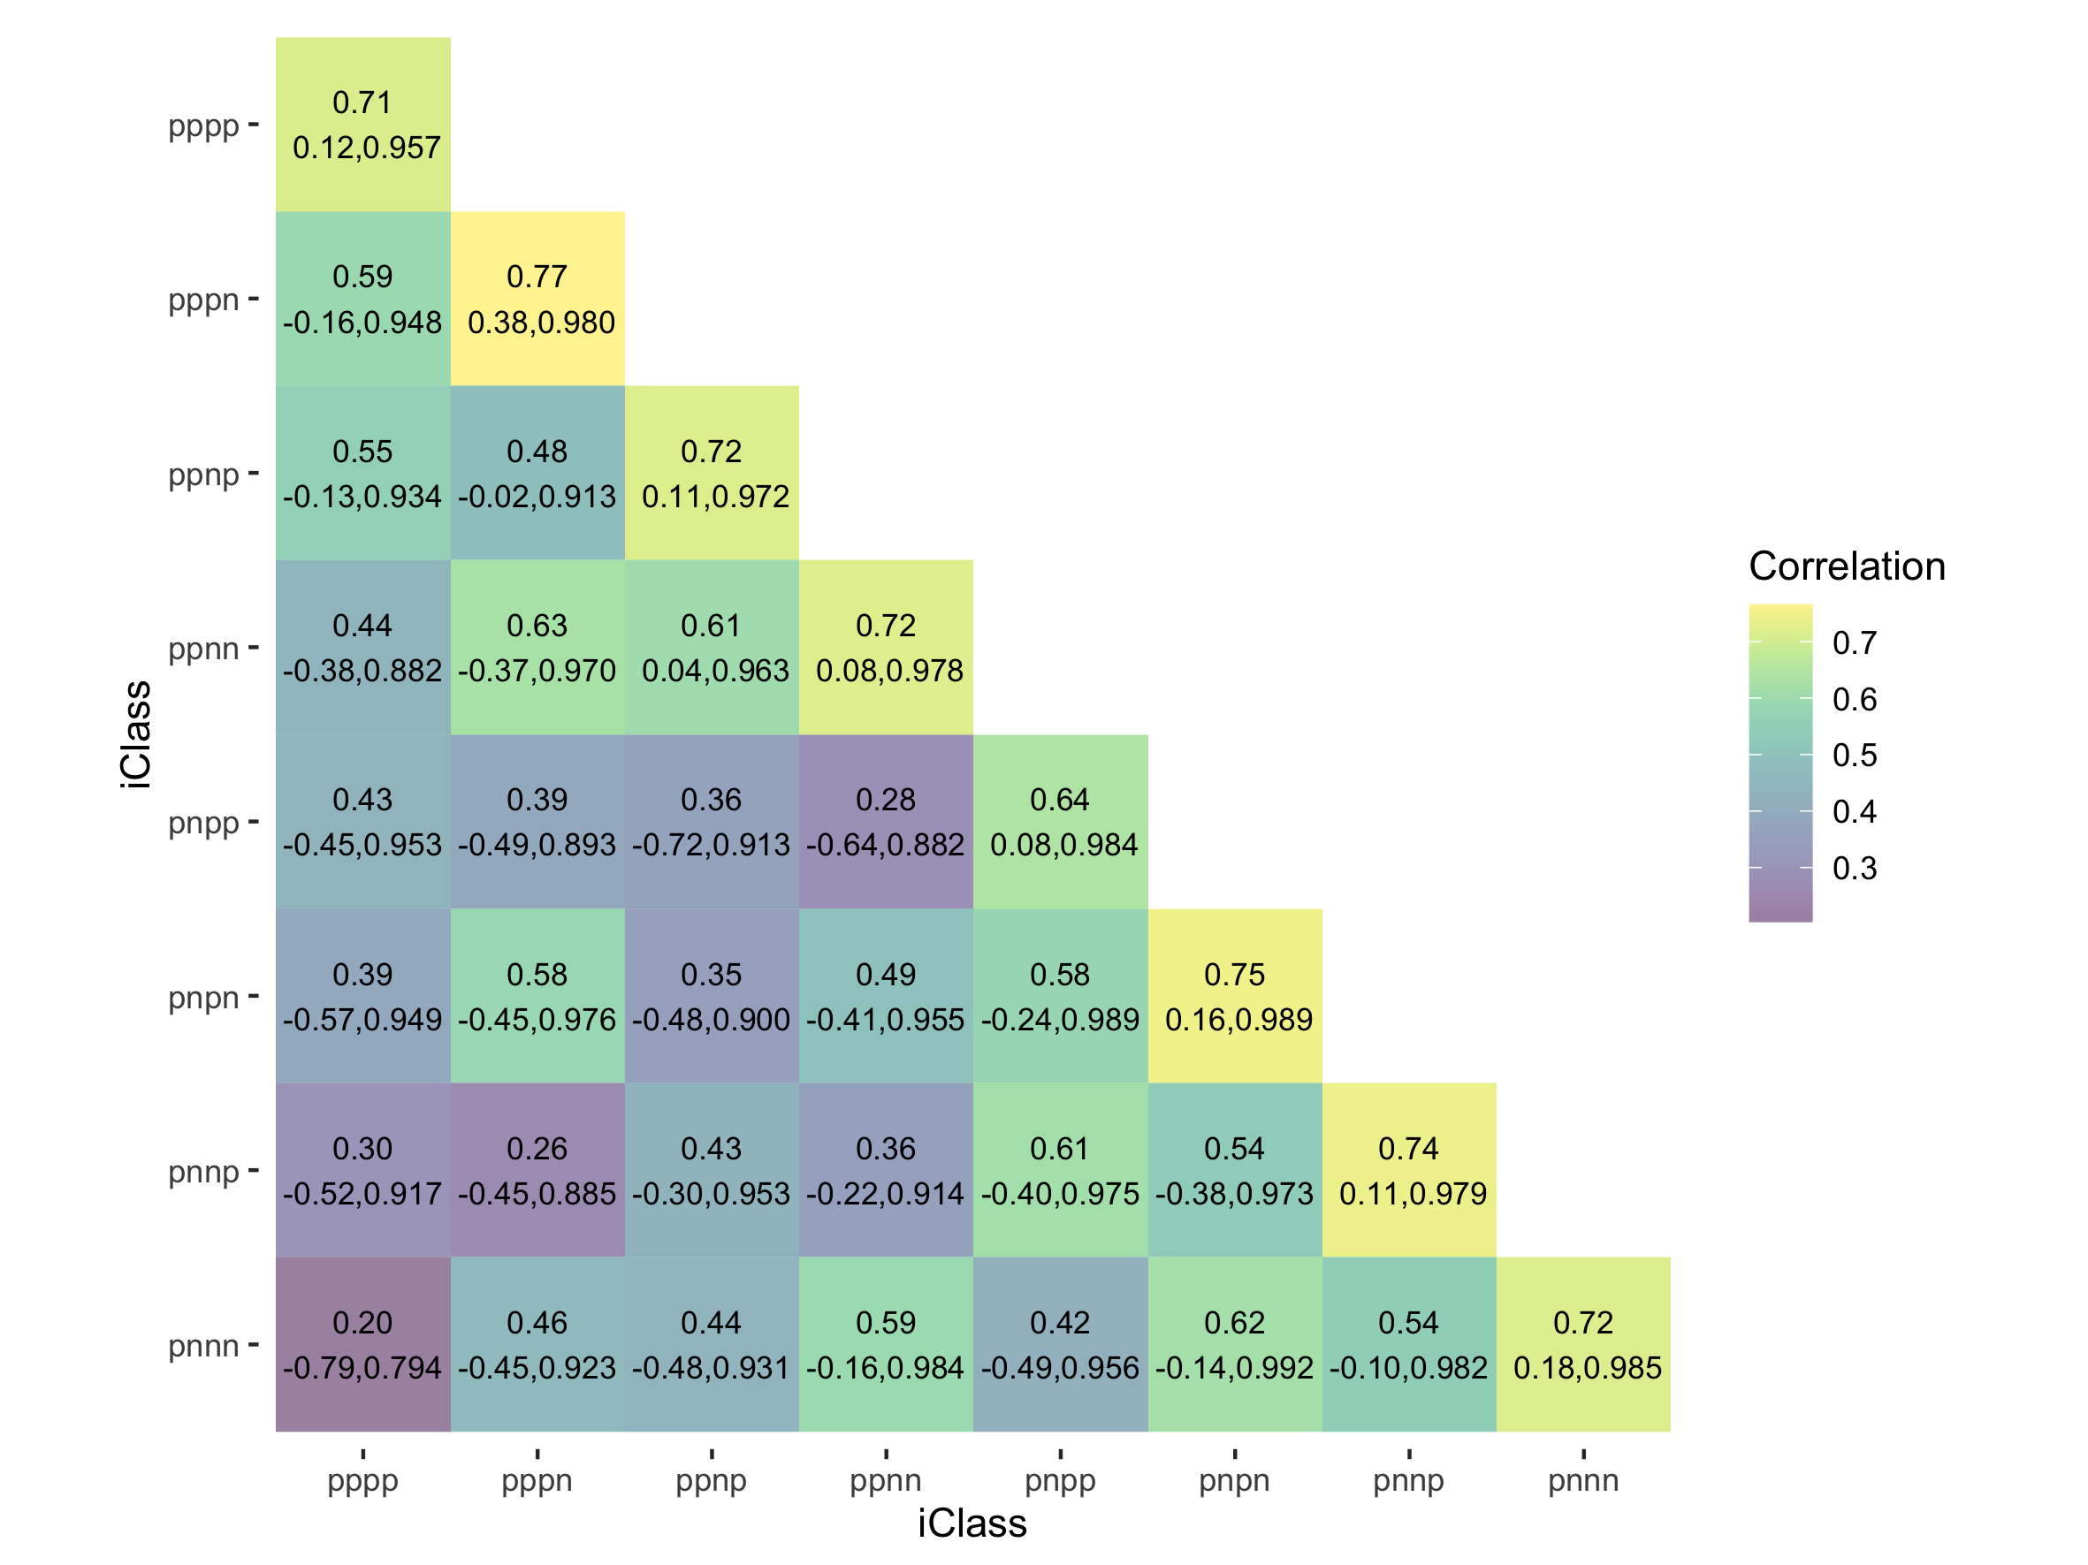
Notes:
We can plot a heatmap of the mean estimated correlation between environments within and across iClasses without the need for applying a clustering algorithm.
Along the diagonal we can see that these correlations are quite high, agreeing with our statement that these iClasses are environment groupings with minimal cross-over VEI.
Furthermore, researchers can use plots like these to investigate environments within and across iClasses to understand the implicit covariates driving each iClass that is, what’s causing these groupings of Environments

Slide 26
Summary
iClass technology allows researchers to use varieties with known VEI patterns to make comparisons across environment groupings with minimal cross-over VEI.
iClass Overall Performance (iClassOP) accounts for the VEI present within a data-set unlike FAST.
This method of forming groups does not involve the application of generic clustering methods to results extracted from the FALMM. They are a direct consequence of the model used for analysis.
Notes:
READ
READ
This method of forming groups does not involve the application of generic clustering methods to results extracted from the FALMM (such as the estimated genetic correlation matrix).
Instead, iClasses are formed because of the fundamental parameters of the FA model, namely the environment loadings, and so are a direct consequence of the model used for analysis.

Slide 27
References
Hughes, David G. D., William Fairlie, Marijka Batterham, Alison B. Smith, and Brian R. Cullis. 2022. “On the Use of Factor Analysis and iClasses to Assess Variety by Environment Interactions in Falling Number Across Australia.” Manuscript in preparation.
Mares, D. J. and Mrva, K. 2014. “Wheat grain preharvest sprouting and late maturity alpha-amylase.” Planta 240 (6):1167–1178
Sjoberg, Stephanie M., Arron H. Carter, Camille M. Steber, and Kimberly A. Garland Campbell. 2020. “Application of the Factor Analytic Model to Assess Wheat Falling Number Performance and Stability in Multienvironment Trials.” Crop Science 61 (1): 372–82. https://doi.org/10.1002/csc2.20293.
Smith, Alison B., and Brian R. Cullis. 2018. “Plant Breeding Selection Tools Built on Factor Analytic Mixed Models for Multi-Environment Trial Data.” Euphytica 214 (8). https://doi.org/10.1007/s10681-018-2220-5.
Smith, Alison B., Adam Norman, Haydn Kuchel, and Brian R. Cullis. 2021. “Plant Variety Selection Using Interaction Classes Derived from Factor Analytic Linear Mixed Models: Models with Independent Variety Effects.” Frontiers in Plant Science 12 (September). https://doi.org/10.3389/fpls.2021.737462.

